Slide 1
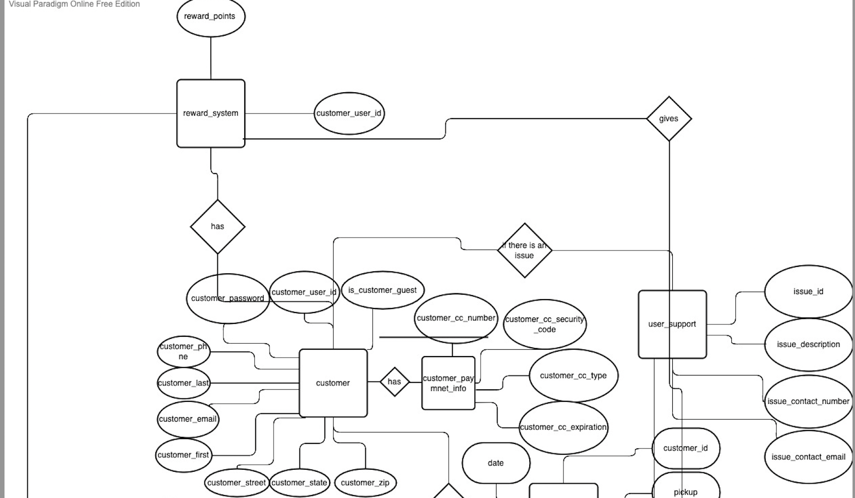
Team 2 Conceptual ER Diagram

Slide 2
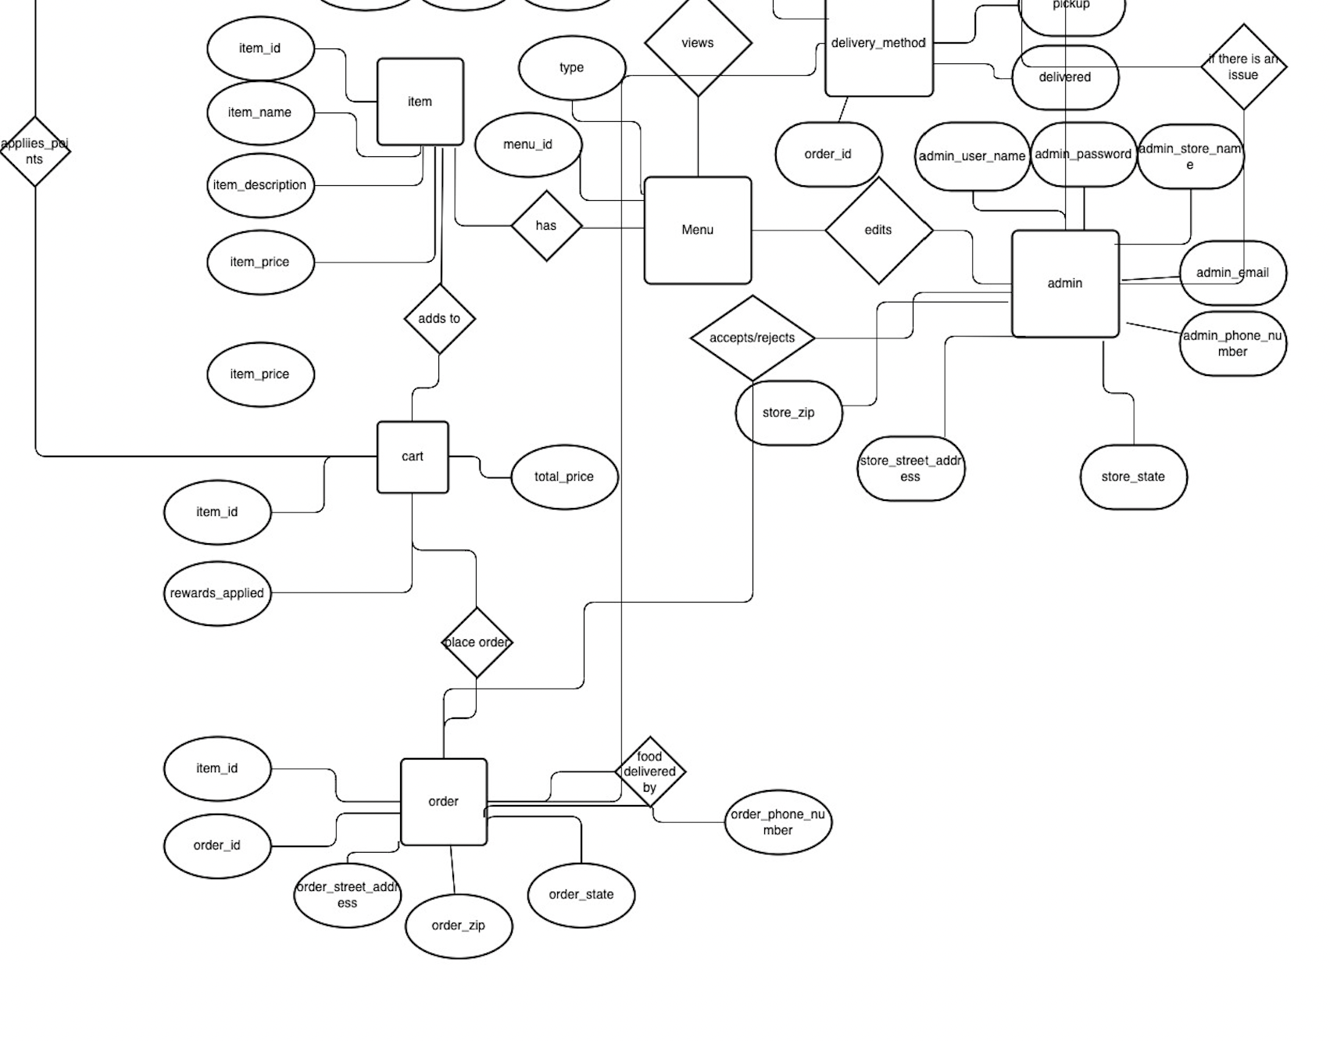
Team 2 Conceptual ER Diagram Cont.

Slide 3
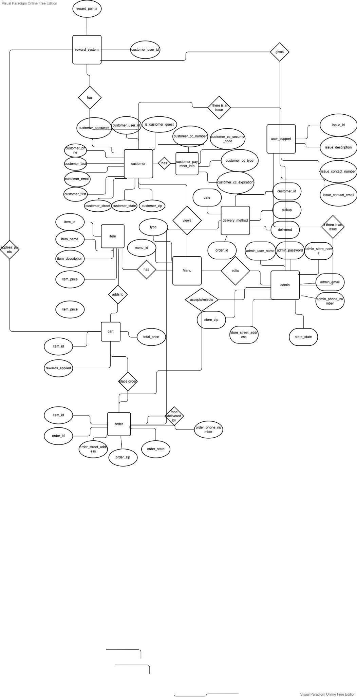
Team 2 Conceptual ER Diagram Full Diagram

